Slide 1
IEA-HTS-Exco, at CICG, Geneve, Switzerland
HTS Activity: China Update
Yutaka Yamada (IEA-HTS OA, SSTC: Shanghai Superconductor Technology Co. Ltd)
Sept. 20, 2017
1
Notes:
Today I would like to introduce “HTS Road Map for Power Applications”, which was done by IEA-HTS-IA.
Here are the authors, me, xxx, yyy, and the committee members of IEA-HTS-IA.

Slide 2
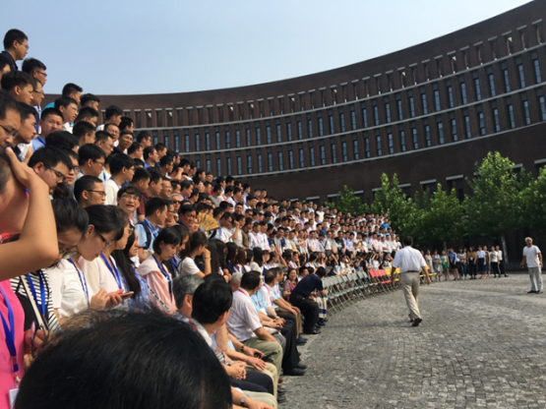
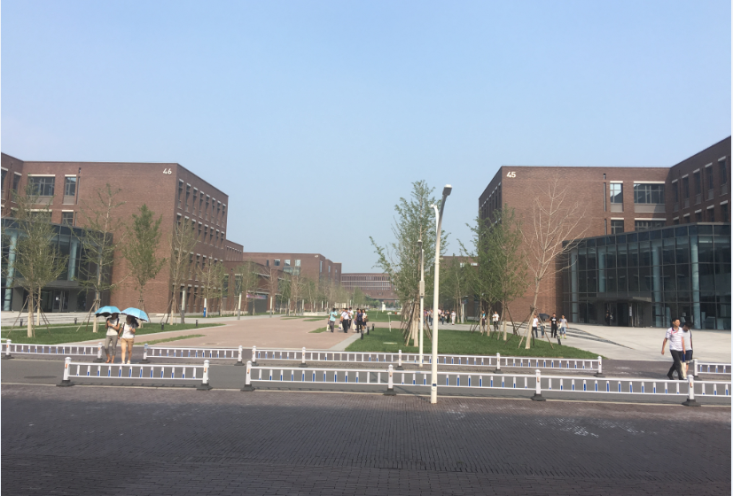
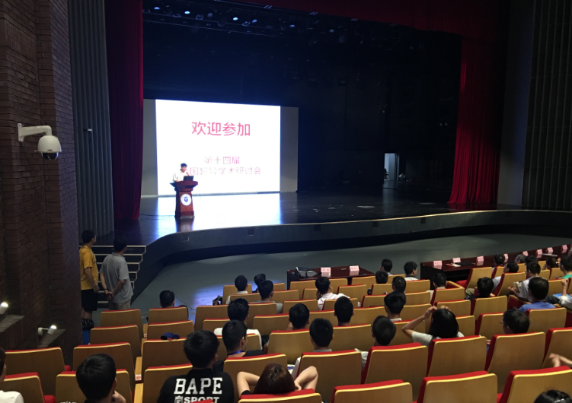
14th Chinese ASC, Tianjin University, Aug. 20-24, 2017.
Attendant: 620
PL 12, Oral 144, Poster 212
Exhibition and sponsor: 14 companies Futong group, Western STC, CSIC(Nanjing), SSTC , SCSTC, Sumitomo, Innost,….
Contents: Like US ASC wire, applications, device, characteristic
Topics HTS cable site tour (Futong group works) HTS cable discussion meeting
Tianjin Univ. and all attendants group photo before meeting
campus
PL

Slide 3
Recent Features on Chinese HTS R&D
From 14th Chinese ASC, Tianjin University, Aug. 20-24, 2017.
YBCO wire 3 companies in Shanghai area
Fe wire in CAS, Beijing
Active Applications FCL: high voltages, DC Cables: Tian Jing (Futong group), Shanghai
Others Xian group (LTS+ HTS)
MRI

Slide 4
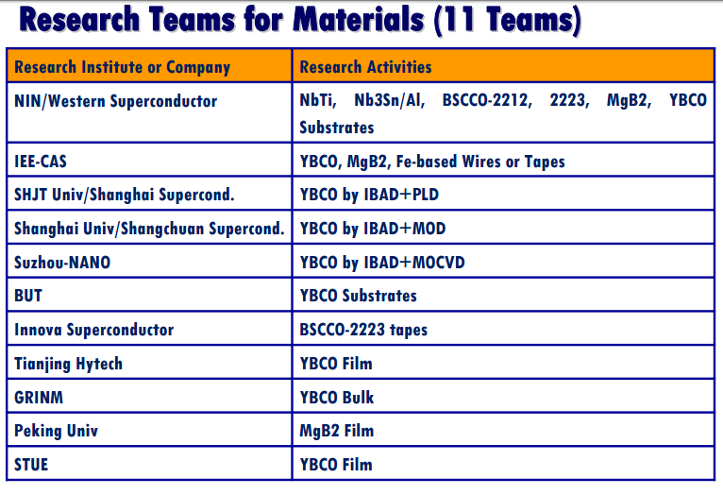
China
2G HTS Wire Venture Company in Shanghai Area
Group | Buffer |  | HTS
Company/ University | IBAD | NiW | PLD | MOD | MOCVD
Shanghai Supercond. Technol. Co., Ltd (SSTC)/ Shanghai Jiao Tong Univ. | R2R |  | R2R
Shanghai Creative Supercond. Technol. Co., Ltd (SCSTC)/ Shanghai Univ. | R2R | R2R |  | R2R
Suzhou Advanced Materials (SAMRI) | R2R |  |  |  | R2R
Dr. Xiao of CAS, Beijing

Slide 5
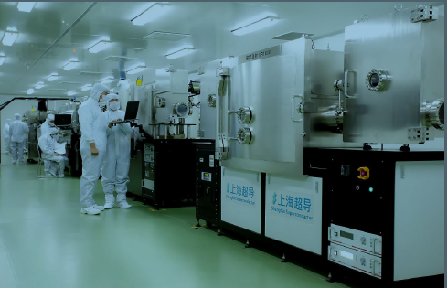
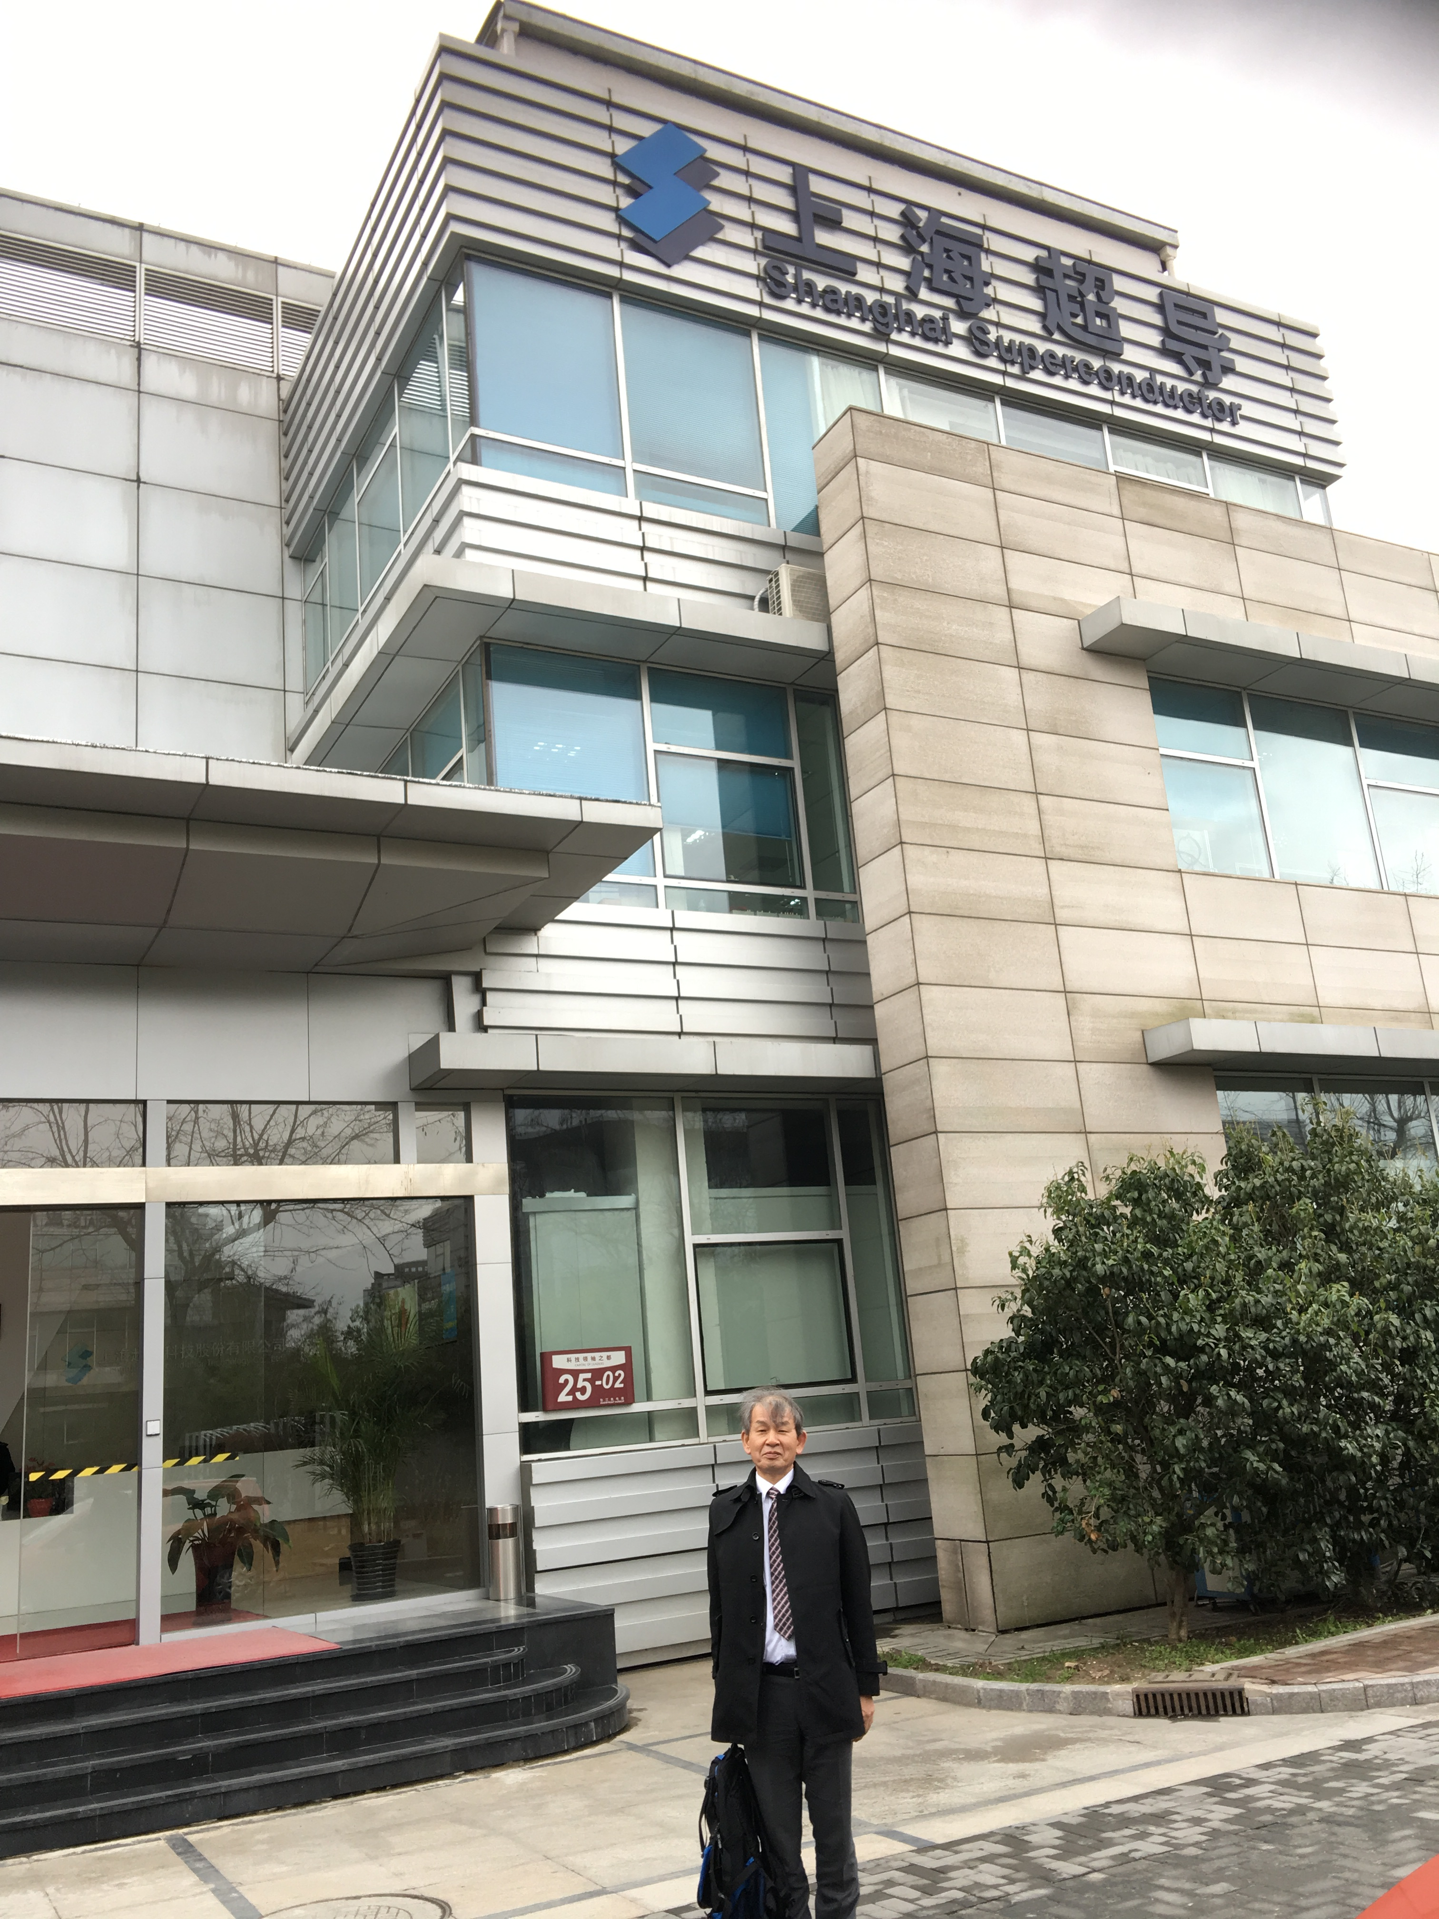
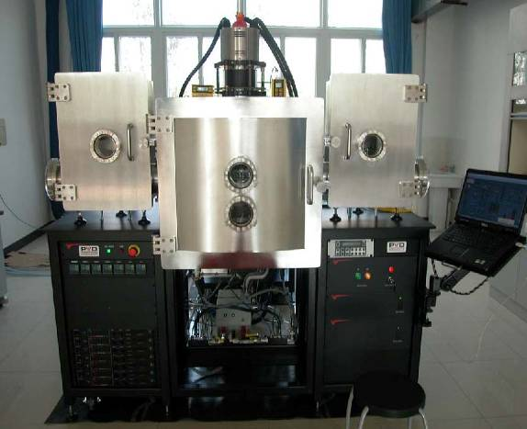
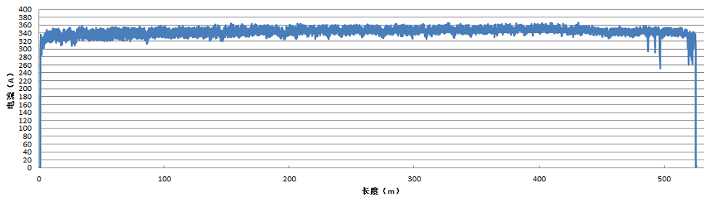
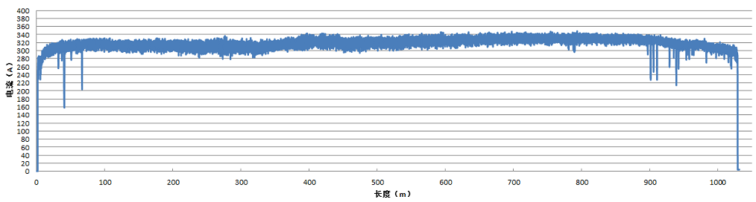
SSTC Shanghai Superconductor Tech. Co., Ltd, SJTU
PLD-YBCO line
at SSTC
500m
Ic>300 A/cm-width @77K
1000m
Ic>300 A/cm-width @77K
PLD -YBCO on IBAD with sharp texture now 1000m length

Slide 6
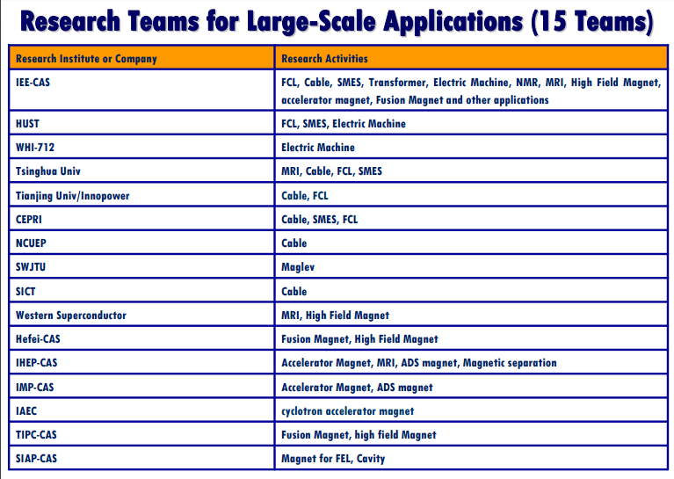
Cable, FCL active
Dr. Xiao of CAS, Beijing

Slide 7
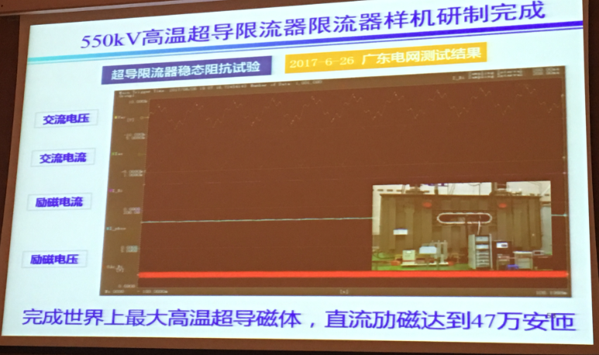
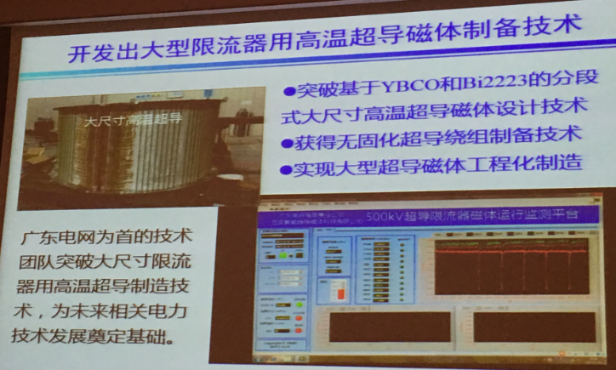
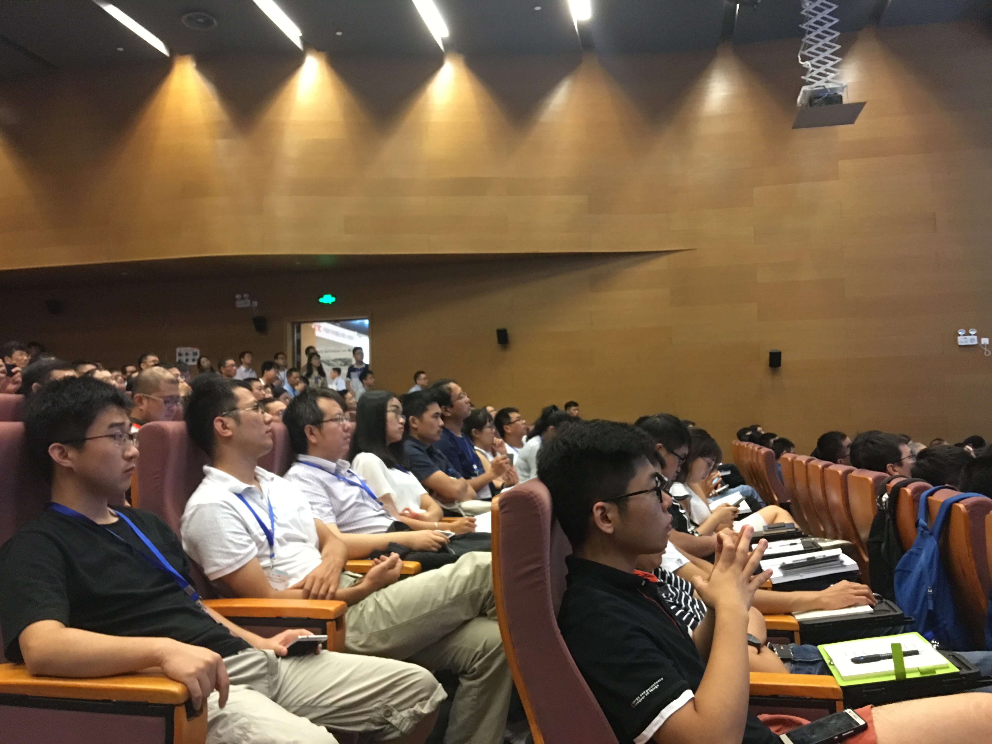
550kV FCL at Xian group
FCLx2
Cable
Wire Y, Fe
Meeting
Project
550kV
Y+Bi wire
470KAT

Slide 8
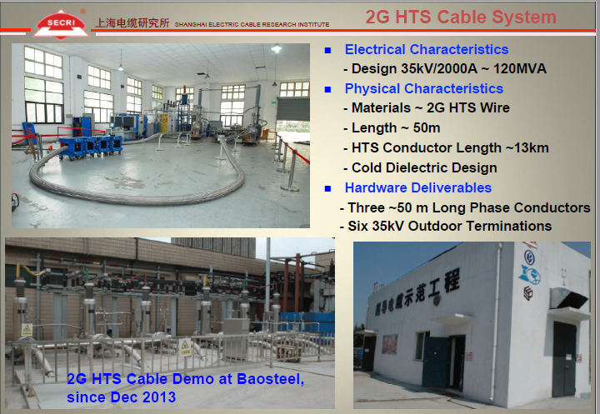

Slide 9
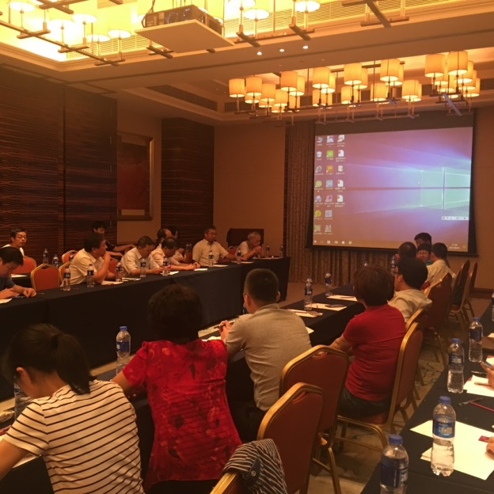
Discussion for HTS Cable, Tianjin, 2017 Aug. 22 night
Members: Wire, Ref., Electric power companies, professors
at the conference hotel in Tianjin

Slide 10
HTS Cable Demonstration Site Tour Aug. 24
Pudong Group (Optical fiber)
Site: Tianjin Works
HTS cable demo.
35kV, 1kA, 1km
YBCO
SWCC wire, cable supply
Conference program

Slide 11
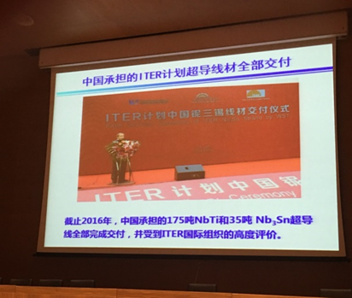
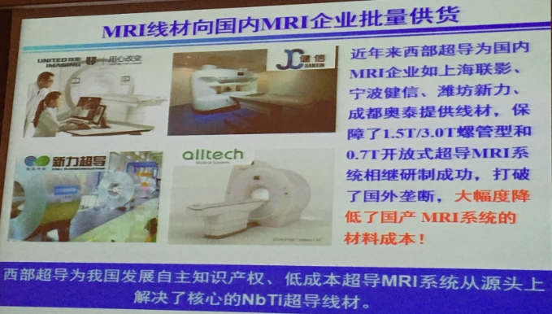
Others
LTS, Fusion
Ceremony of ITER for the conductor: All conductor has successfully supplied.
MRI
MRI industry now
growing rapidly
in China. Many companies emerged.
Prf. Zhang of NIN, Xian.

Slide 12
Progress of SC and its application in China
Materials
YBCO CC: 50m, Ic=140A@77K
Laboratory scale
YBCO CC: 1000m, Ic=280A@77K
Industry scale
LTS：
Starting mass production
180t NbTi and 30t Nb₃Sn strands for ITER, 100t strands for MRI and HEP application
2011
2012
2013
2014
2015
Application
Power DEMO：HTS Power Substation
Cable：
380m, 10000A DC
FCL：
220kV, 3 Phase
FCL：
550kV, 3 Phase
In China still continuing active HTS R&D
Prf. Zhang of NIN, Xian.

Slide 13


















Institutes trying HTS (YBCO) Application
二代高温超导产业园（planning）
哈工大
中科院电工所
中科院高能所
清华大学
北京交通大学
中船重工725所
中天科技
华北电力大学
东方电气集团
中科院应物所
四川大学
上海电气
西南交通大学
中科院等离子所
东方电气
联创光电
重科院
南方电网公司
华为公司
中科院深先院
Many potential users of HTS !

Slide 14
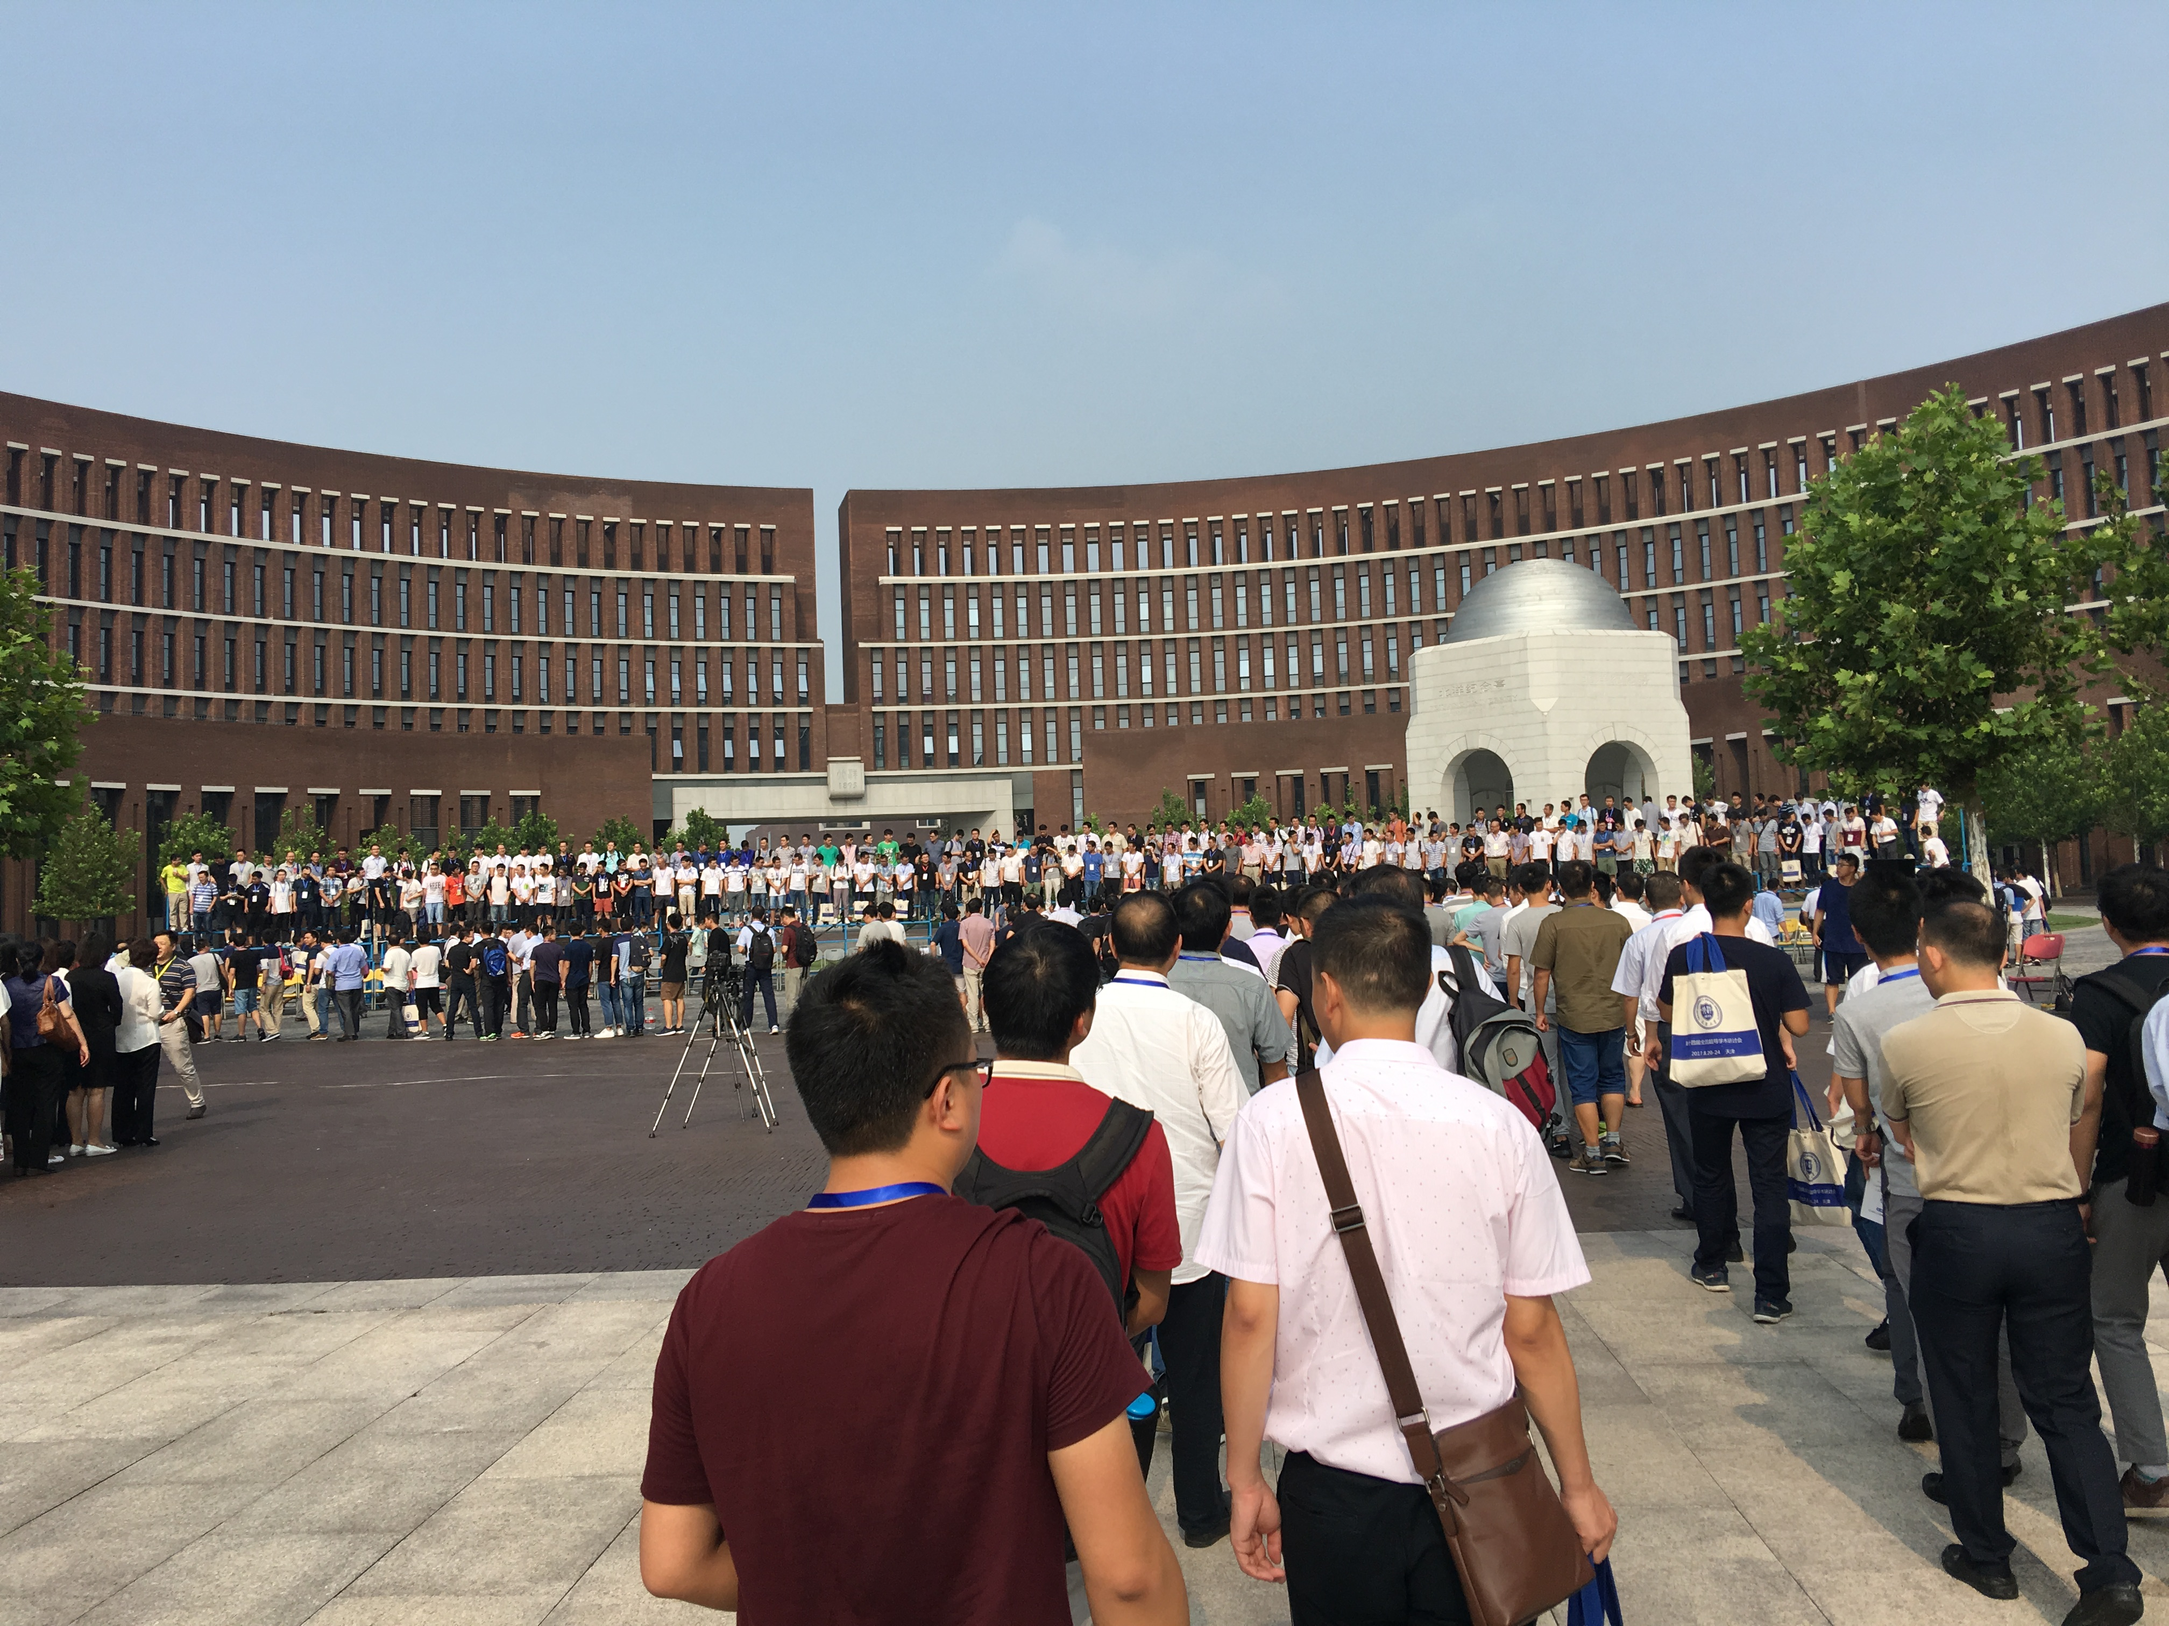
14th Chinese ASC, Tianjin University
Many attendant gathered from almost all area in China.

Slide 15
END

